Slide 1
Chapter 2: Stress and Strain-Axial Loading
Chapter End Problems: 2.21-2.23, 2.25-2.28

Slide 2
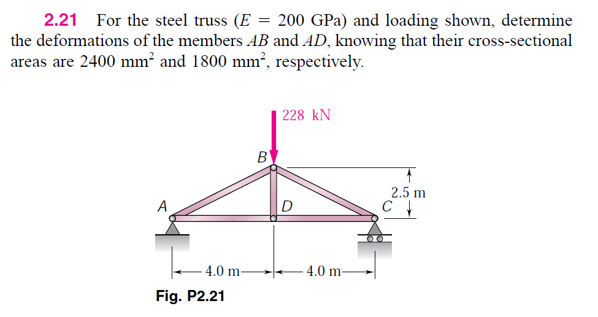

Slide 3
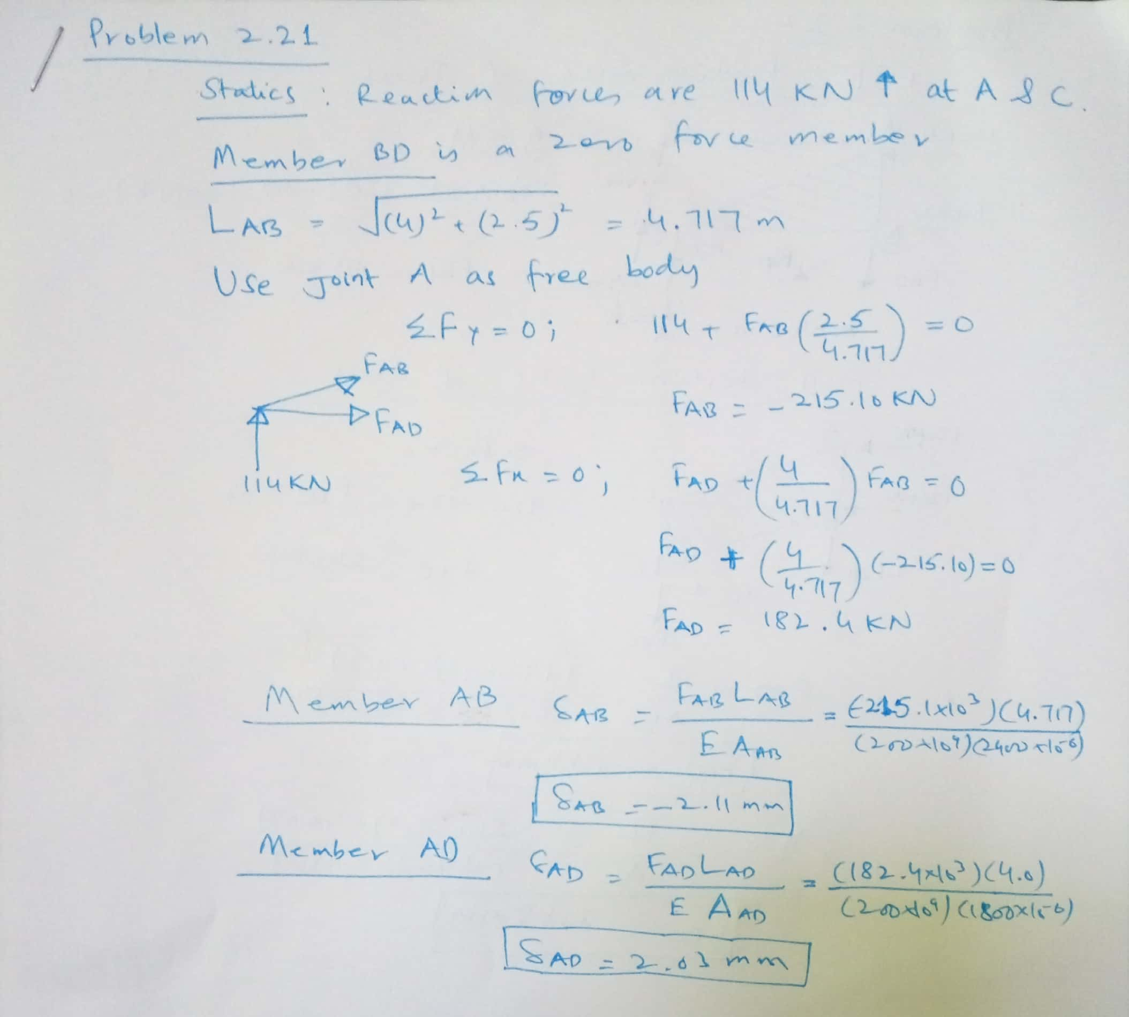

Slide 4
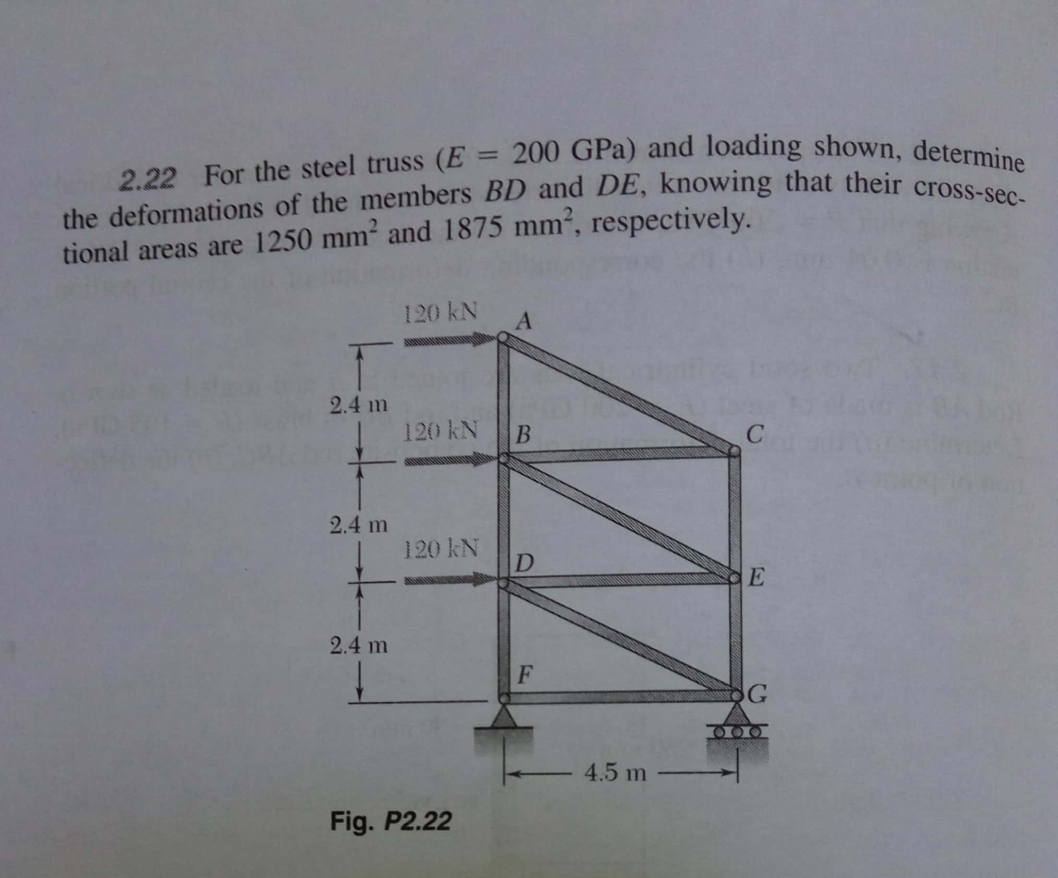

Slide 5
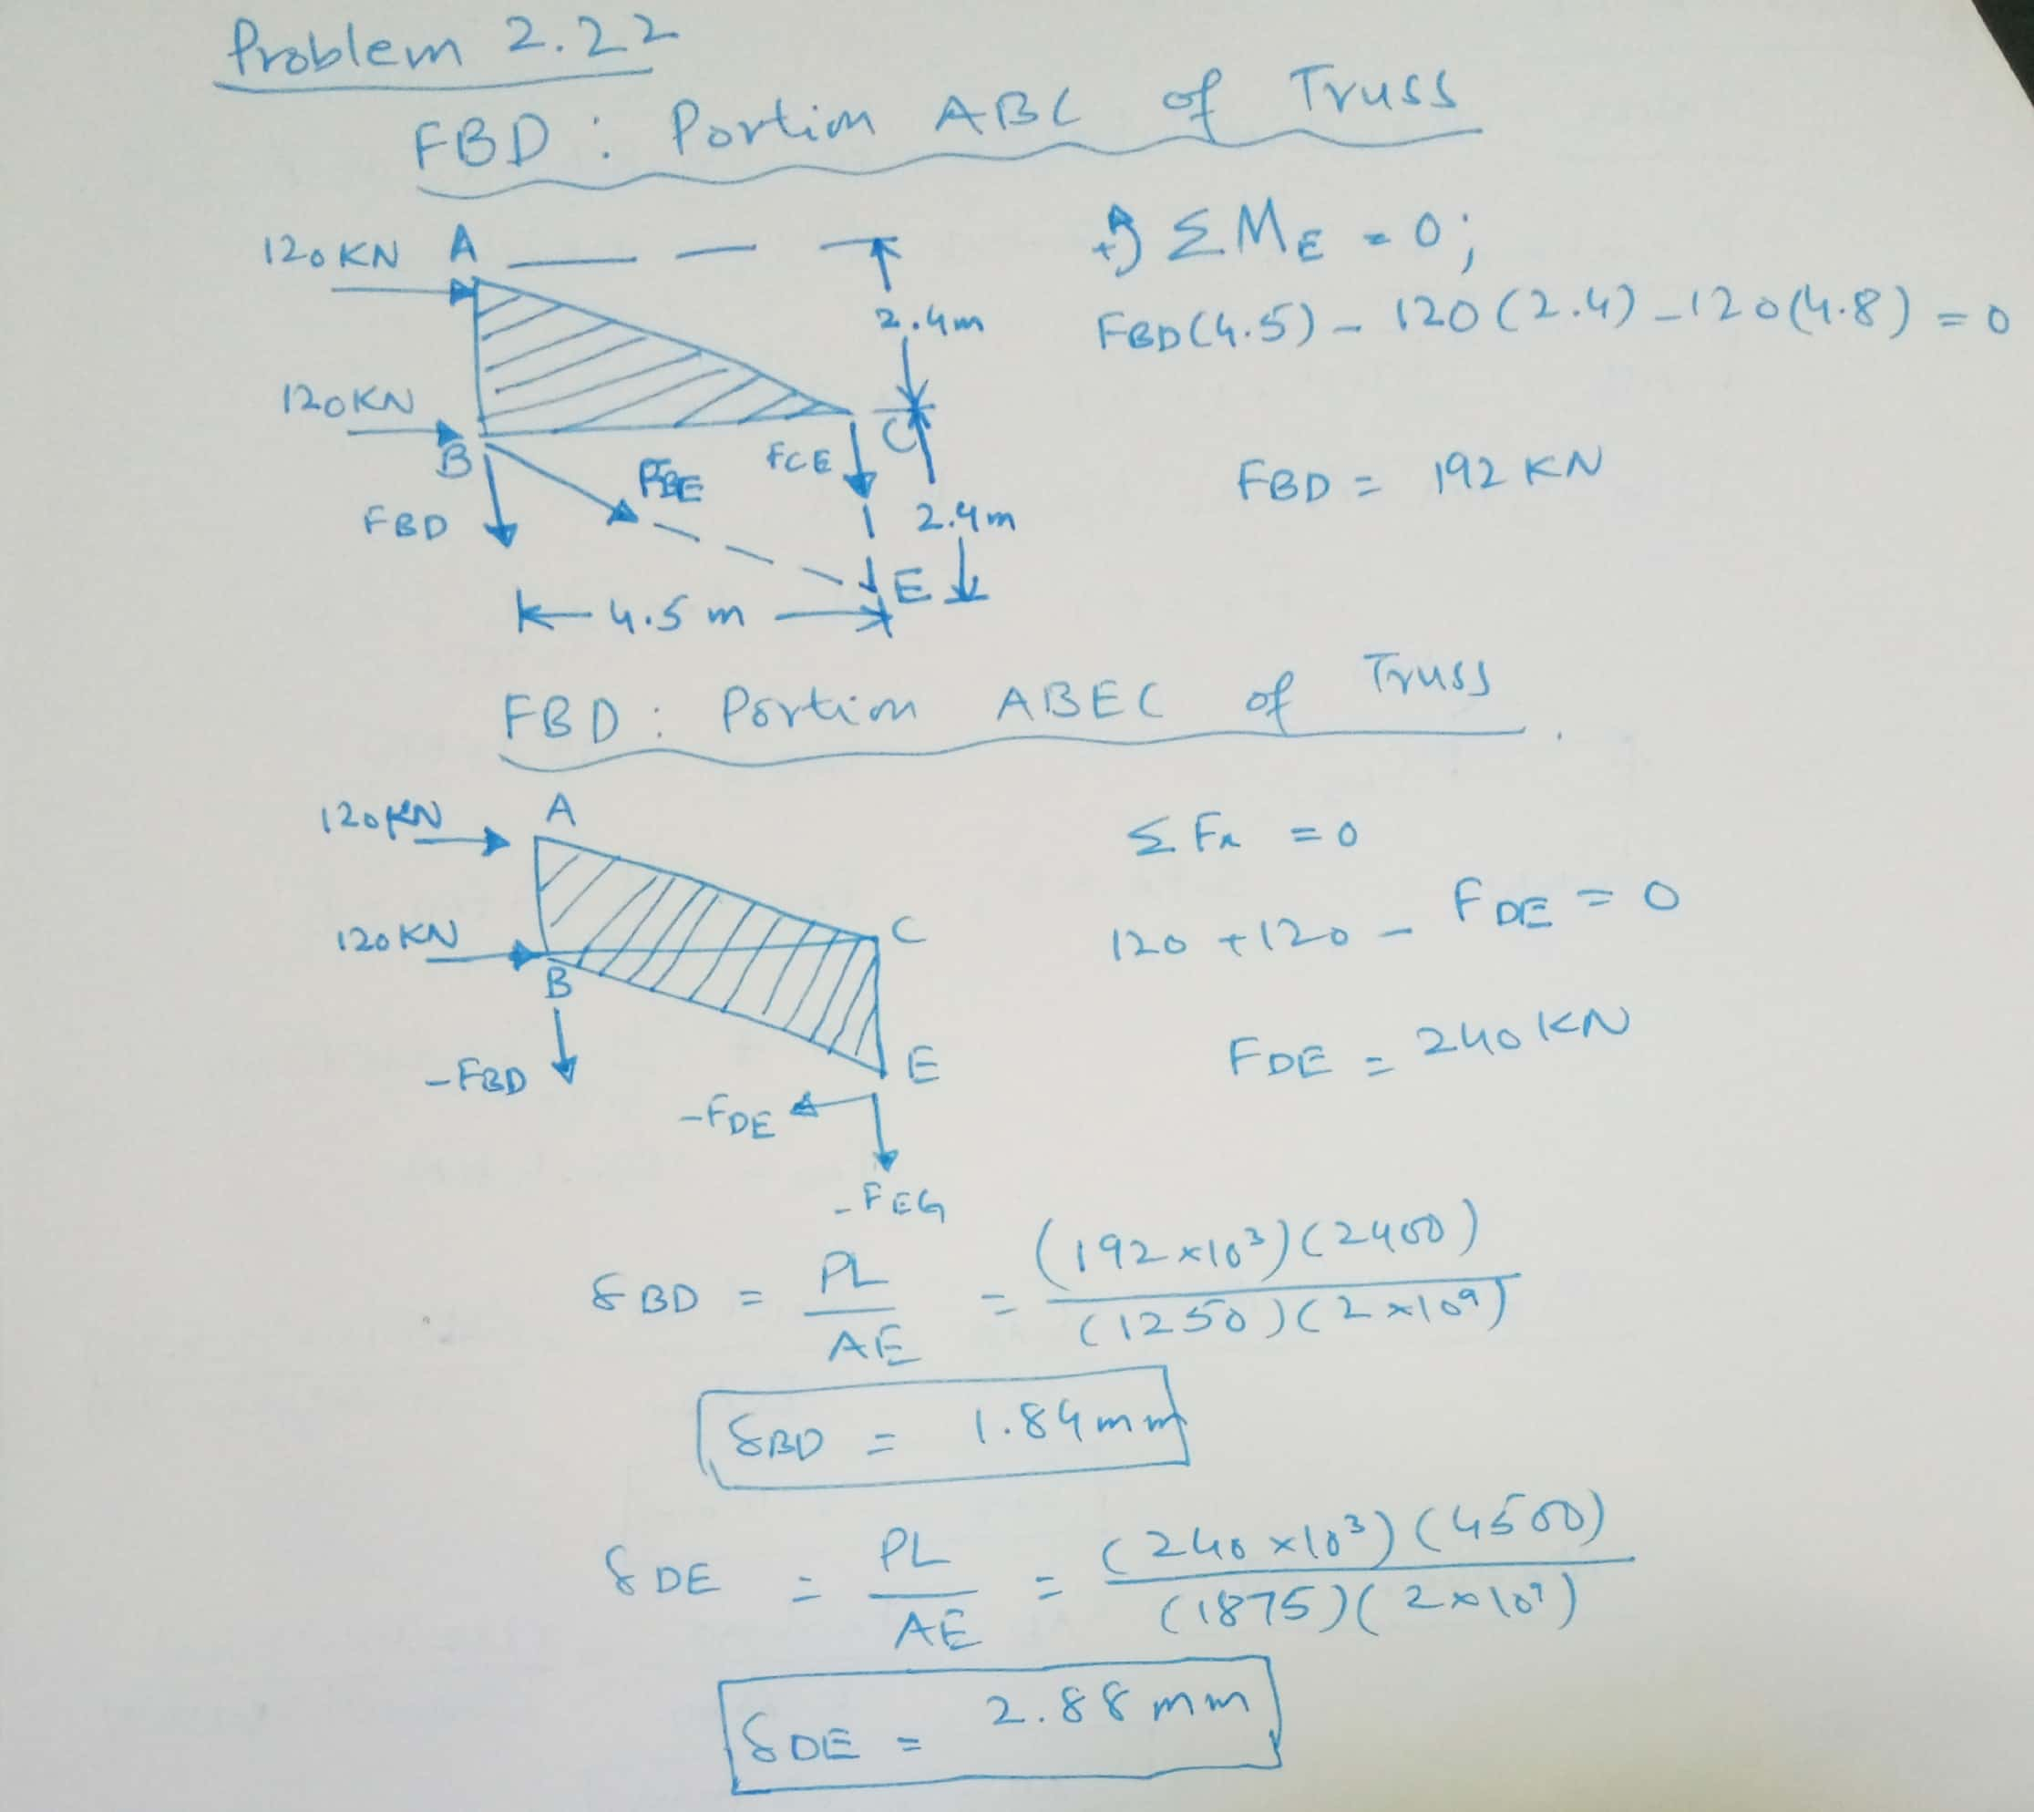

Slide 6
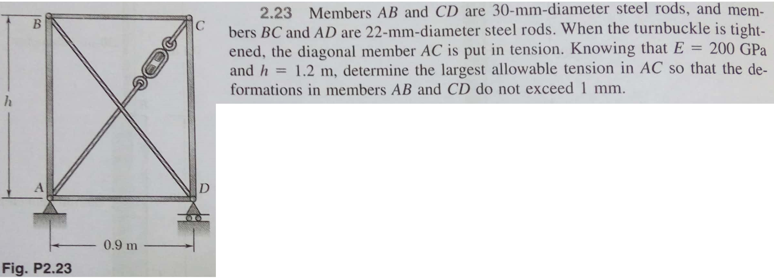

Slide 7
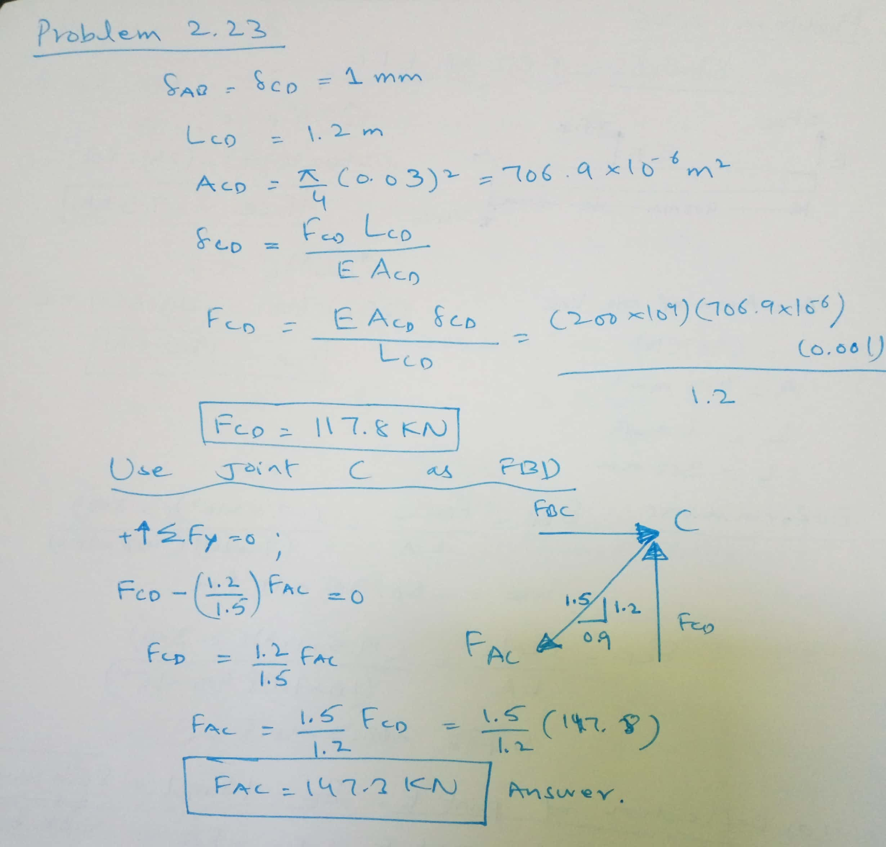

Slide 8
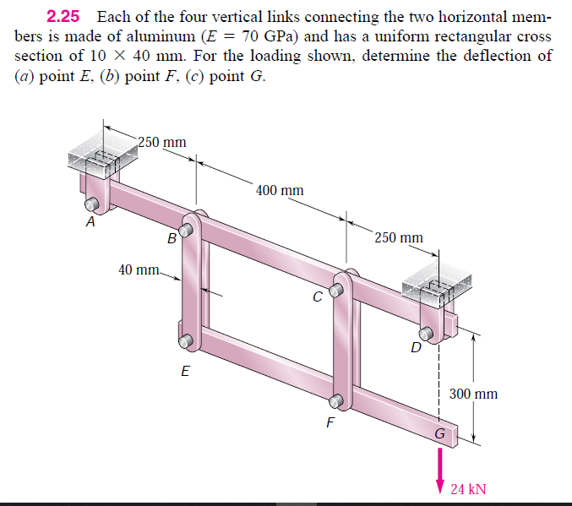

Slide 9
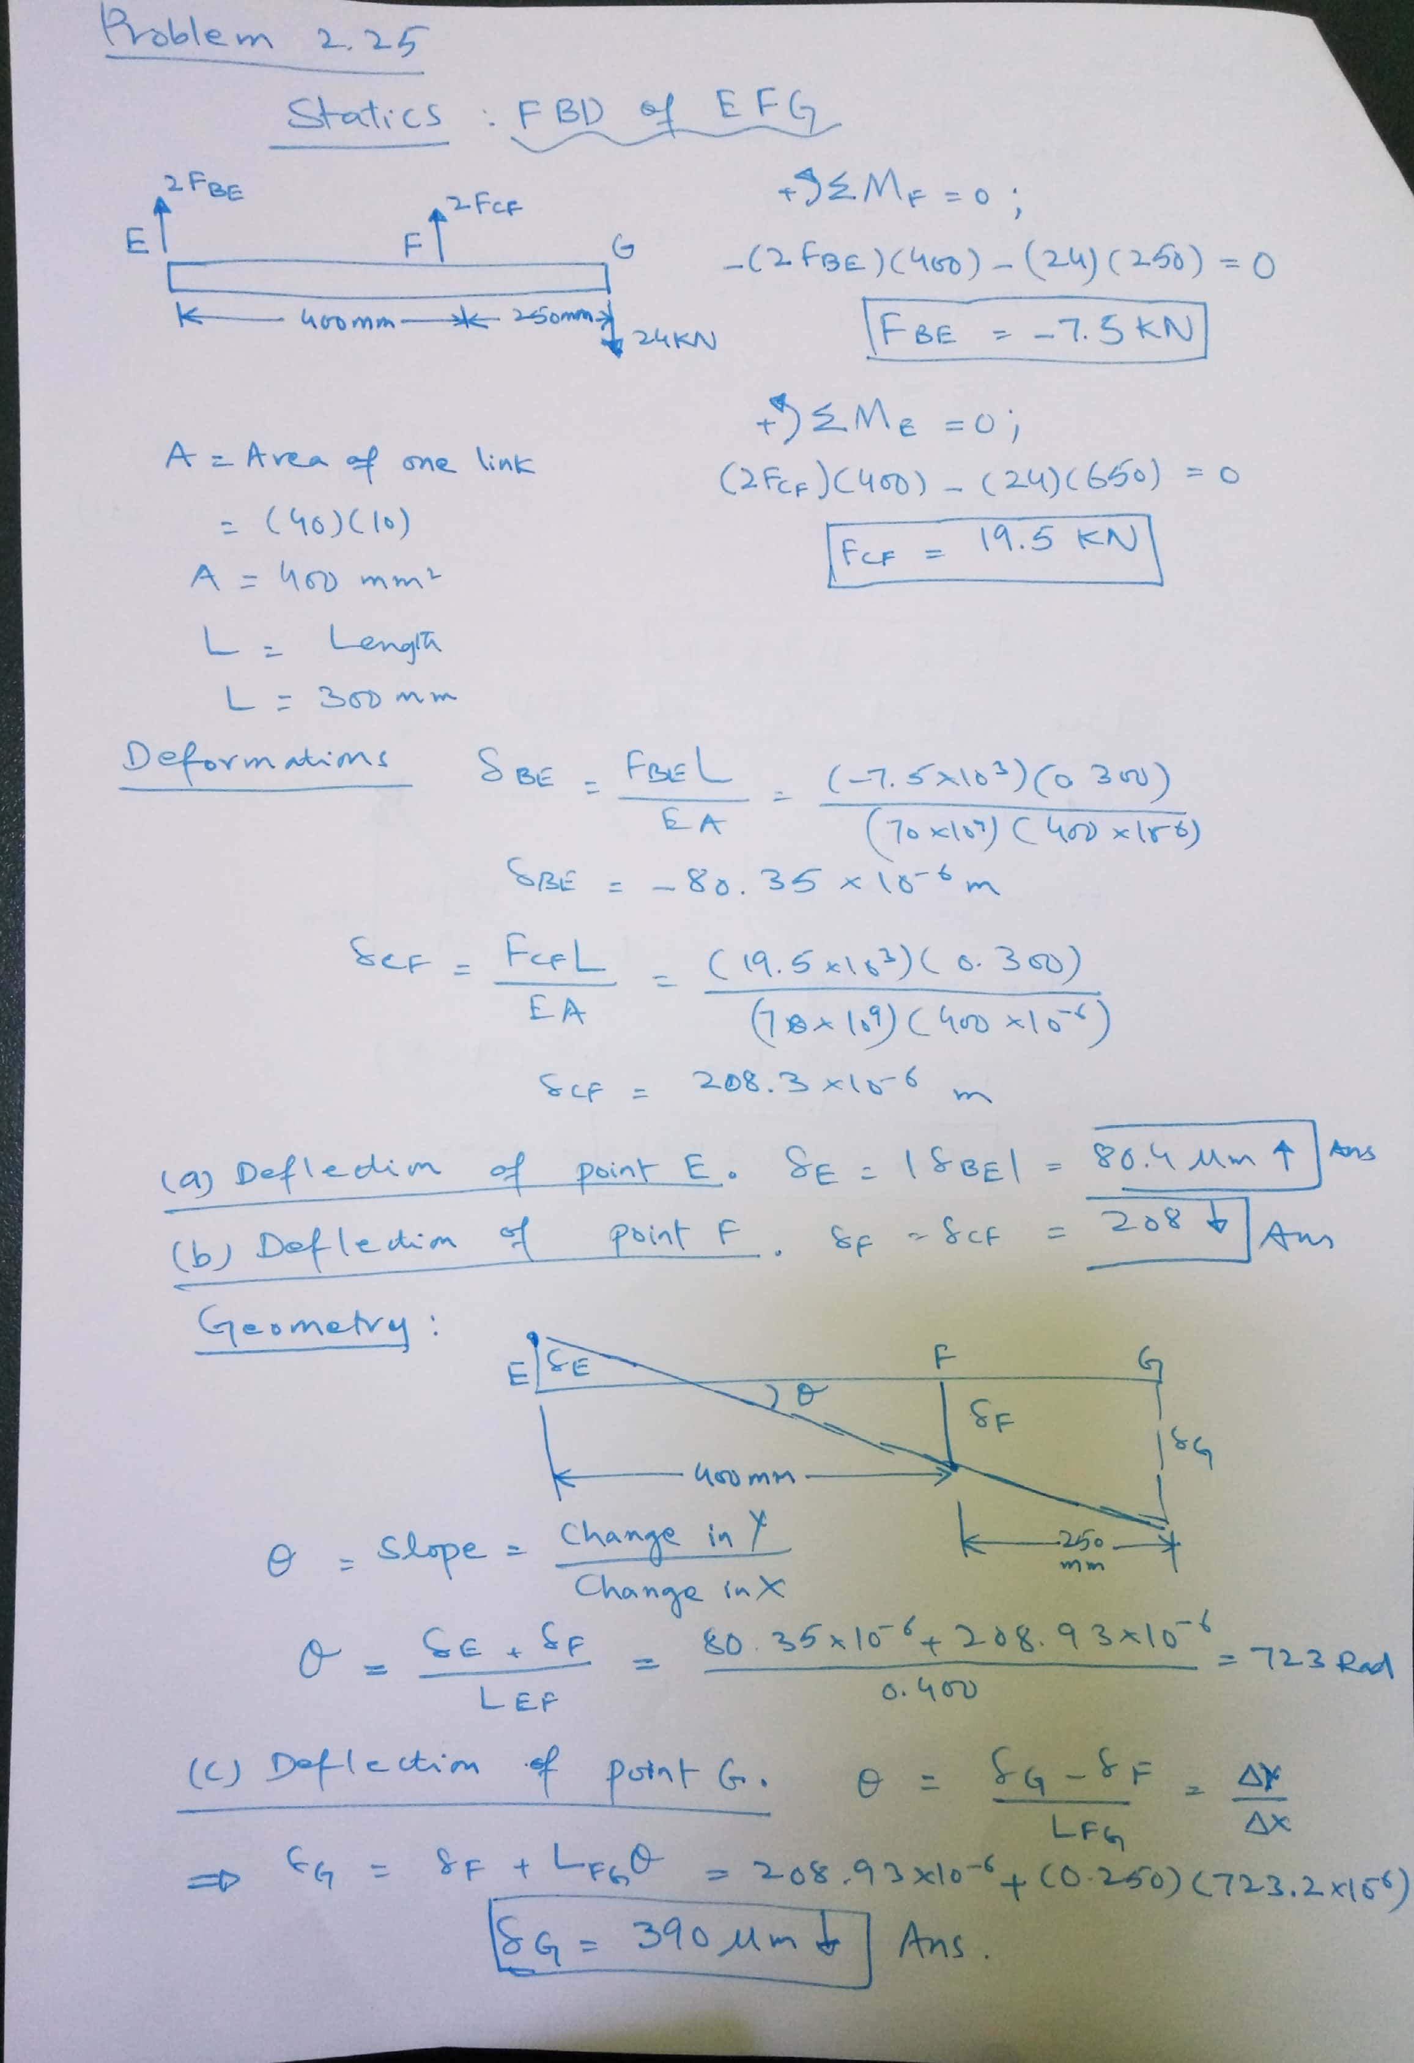

Slide 10
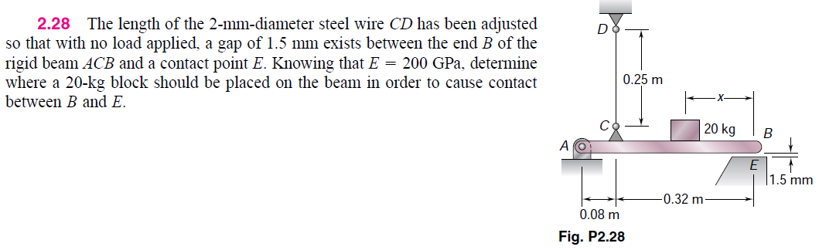

Slide 11
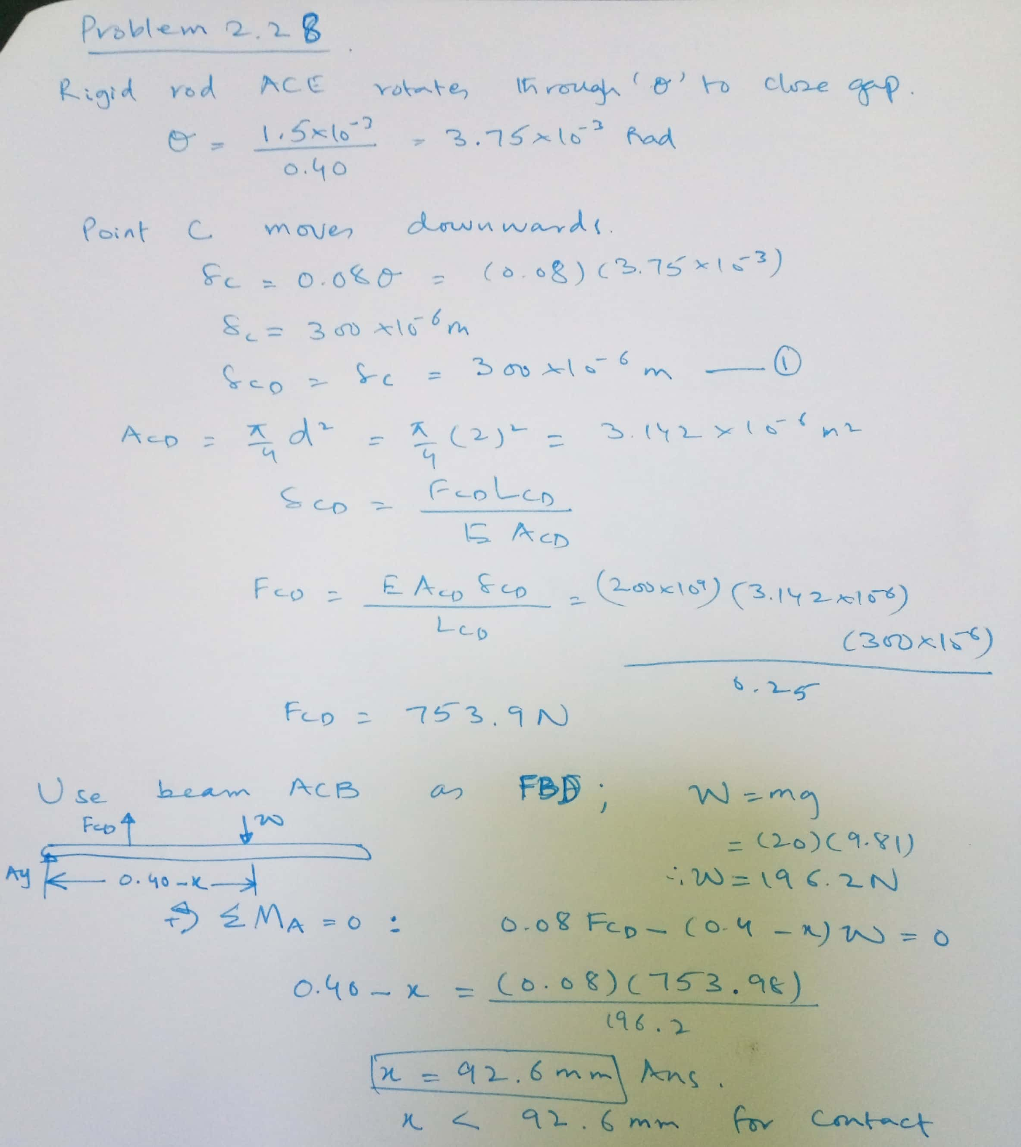

Slide 12
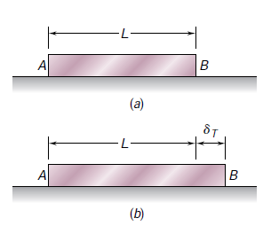
PROBLEMS INVOLVING TEMPERATURE CHANGES
All structures considered previously were supposed to have no change in temp.
Let us first consider a homogeneous rod AB of uniform cross section, which rests freely on a smooth horizontal surface.
If the temperature of the rod is raised we observe that the rod elongates by an amount which is proportional to both the temperature change and the length L of the rod.

Slide 13
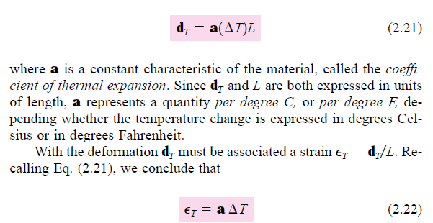
PROBLEMS INVOLVING TEMPERATURE CHANGES
The strain is referred to as a thermal strain, since it is caused by the change in temperature of the rod.
In the case we are considering here, there is no stress associated with the strain.

Slide 14
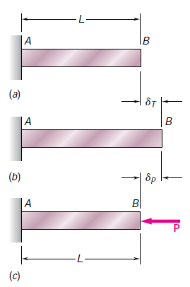
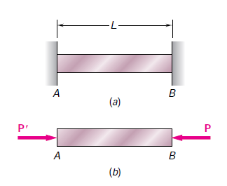
Let us now assume that the same rod AB of length L is placed between two fixed supports at a distance L from each other

Slide 15
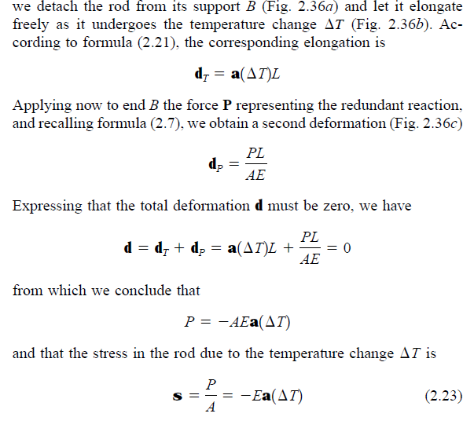

Slide 16
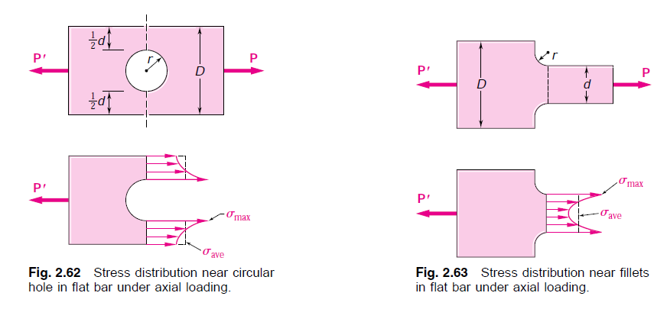
STRESS CONCENTRATIONS
The stresses near the points of application of concentrated loads can reach values much larger than the average value of the stress in the member.
When a structural member contains a discontinuity, such as a hole or a sudden change in cross section, high localized stresses can also occur near the discontinuity.

Slide 17
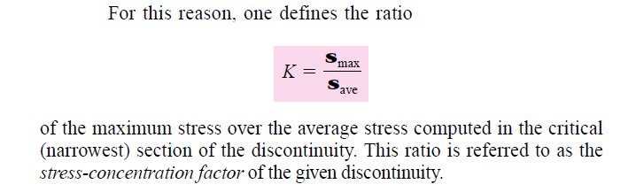
STRESS CONCENTRATIONS
These results were obtained using photoelastic method.
Fortunately, if such an analysis is unaffordable, the results are independent of the size and material of the member.
The results depend on ratios of the geometric parameters involved.
The designer is more interested in the maximum value of the stress.

Slide 18
